Slide 1
Pipetronics - Autonomous Leak Detecting Robot
Pipetronics is an innovative solution that combines advanced robotics and IoT technology to proactively detect and address pipeline leaks. This intelligent system monitors critical infrastructure, providing real-time data to improve safety, efficiency, and environmental sustainability.

Slide 2

2 BROKE GUYS
1
Lead: Harshith Gowda K
2
Member 2: Jeevitesh Mishra

Slide 3

Pipetronics Overview
Pipetronics offers a cutting-edge inspection robot that serves a wide range of industries. Its compact design and advanced sensors enable it to navigate complex machinery, assess pipeline integrity, and detect early signs of wear or leaks in critical infrastructure.
Leveraging powerful imaging and sensor technologies, the Pipetronics robot provides precise, location-specific data that enhances safety, minimizes downtime, and ensures the reliability of essential systems in petrochemical, gas distribution, and industrial settings.

Slide 4
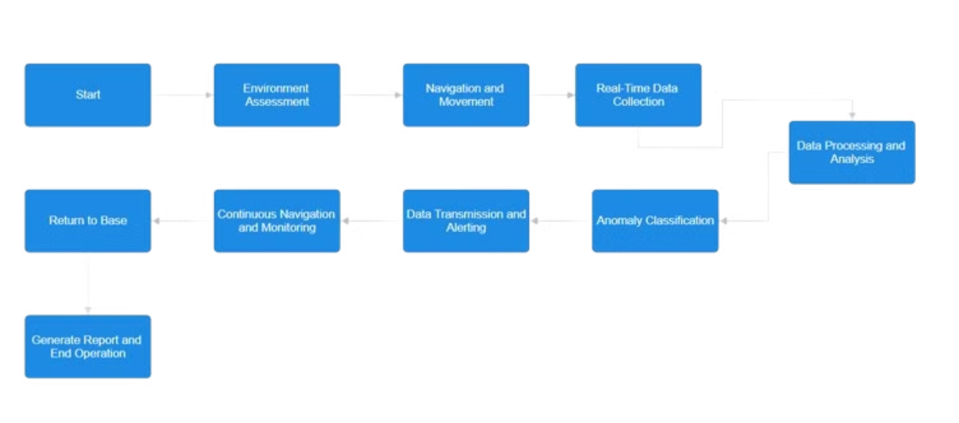
Technical Report Workflow
The technical report workflow at Pipetronics follows a structured process to ensure a thorough and well-researched final product. Starting with ideation and brainstorming, the team moves on to data collection, in-depth analysis, and finally, comprehensive documentation to present the findings and recommendations.

Slide 5
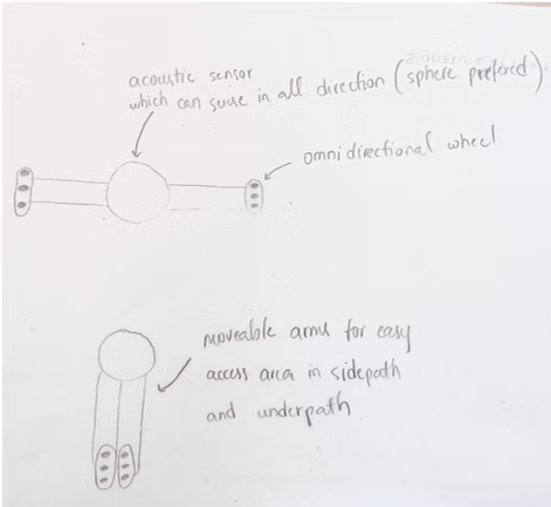




Prototype Key Features
Laser Absorption Spectroscopy (LAS)
Gyro-Stabilized Mobile Platform
Dual-Spectral Imaging
Remote Gas Leak Scanner
Ensures stable, accurate measurements even on uneven terrain, enabling reliable gas monitoring in challenging environments.
Visible and infrared cameras provide comprehensive visual inspections and reliable gas leak detection capabilities.
Detects and quantifies gas concentrations without direct contact, using advanced laser-based technology for efficient inspections.
Measures gas concentrations by detecting specific wavelengths absorbed by gas molecules, providing precise and real-time data.

Slide 6








Feasibility and Viability
Technological Feasibility
Operational Feasibility
Pipetronics leverages proven technologies like laser absorption spectroscopy, dual-spectral imaging, and gyro-stabilization for reliable performance.
Designed for adaptability in remote and hazardous environments, Pipetronics integrates seamlessly with existing infrastructure.
Economic Feasibility
Scalability
The high initial investment is offset by long-term savings from reduced labor costs and minimized downtime.
Effective for large, unmanned, or remote areas, Pipetronics offers broad applicability across industrial networks.
Market Viability
1
Pipetronics meets high demand for safety solutions in the oil and gas industry and aligns with automation trends.
2
Regulatory Compliance
Pipetronics helps companies comply with strict safety and environmental regulations, ensuring responsible operations.
3
Cost-Benefit Ratio
Pipetronics offers a high ROI due to reduced manual labor, downtime, and damage from undetected leaks.
Maintenance Viability
4
Pipetronics has low ongoing maintenance costs due to its autonomous operation and reliable performance.

Slide 7




Impact and Benefits
Enhanced Safety
Remote Operation
Improved Efficiency
Real-Time Data
Detects gas leaks early, reducing the risk of explosions, fires, and hazardous situations.
Operates in hazardous or remote areas without putting human inspectors at risk.
Conducts autonomous, continuous inspections, improving overall operational efficiency.
Sends data wirelessly to operators for swift responses to detected leaks.
Cost-Effectiveness: Reduces the need for manual inspections, cutting labor costs and minimizing downtime.
Precision and Accuracy: Uses laser absorption spectroscopy and dual-spectral imaging for precise leak detection.
Wind Compensation: Anemometer integration improves accuracy of gas concentration measurements in varying wind conditions.
Scalability and Adaptability: Ideal for large, remote sites with limited human presence.
Environmental Protection: Helps prevent harmful gas emissions, protecting the environment.
Data-Driven Insights: Provides detailed data for predictive maintenance and informed decision-making.

Slide 8
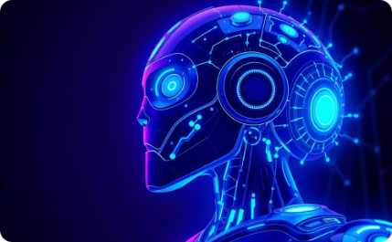

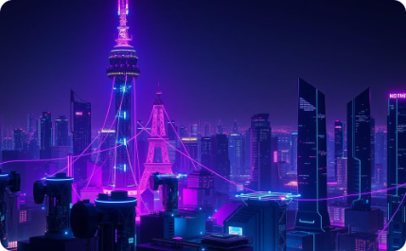


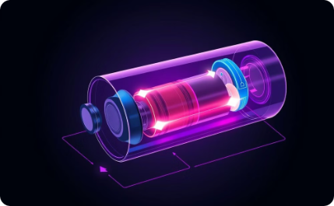
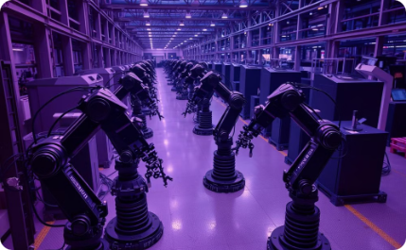

Future Scope
Enhanced AI and Machine Learning
Expanded Multi-Gas Detection
5G and Edge Computing
Miniaturization and Portability
Future AI could improve predictive maintenance and anomaly detection, enabling more proactive industrial operations.
Additional sensors could detect more gases, expanding Pipetronics' applicability across a wider range of industrial environments.
Faster connectivity and local data processing would enable real-time decision-making and reduce latency.
A smaller design could allow access to tighter, hard-to-reach spaces, increasing Pipetronics' versatility.
Environmental Adaptability
Improved Power and Battery Life
Fleet Management
Augmented Reality (AR) Integration
Enhanced durability for extreme conditions would expand Pipetronics' applications in challenging industrial settings.
Advanced batteries would enable longer operational hours, improving productivity and reducing downtime.
Coordinated robot fleets could speed up large-scale inspections, optimizing efficiency and coverage.
AR would allow operators to visually monitor and control inspections, enhancing user experience and situational awareness.

Slide 9




Research and References
Oil Eating Robots
Industry Resources
Academic Studies
Real-World Applications
Cutting-edge research explores the use of autonomous robots to detect and contain gas leaks, preventing catastrophic environmental damage.
Leading industry publications like Pipeline & Gas Journal and Oil & Gas Technology provide in-depth coverage of related technologies and best practices.
Scholarly articles, such as this one from Science Direct, explore the science and feasibility of robotic pipeline inspection and repair.
Case studies like this one from Phys.org
demonstrate the successful deployment of these technologies in the field.
Learn More

Slide 10

Closing Image
As we conclude our presentation on Pipetronics, we leave you with an inspiring image of the future - a vision of seamless integration, boundless innovation, and a world empowered by the power of real-time data processing.

